Slide 1
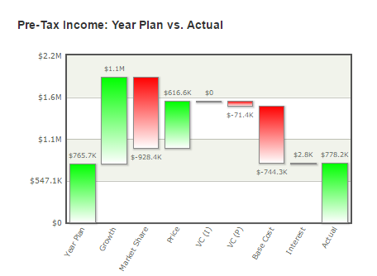
How to Analyze the “Pre-Tax Income: Year Plan vs. Actual (or Actual + SRO)” Chart

Slide 2
This chart tells you what your expected Net Income will be (if you have not completed all four quarters)
or is (if you have completed all four quarters), and what the differences are between the plan and the actual.

Slide 3
In this example, the Planned Net Income – your expected Net Income when you set your original plan
– on a pre-tax basis – was $765k. With a 50% tax rate, your planned after-tax Net Income was about $382k,
which is within the owner’s range of $300k to $400k. Remember that this chart will always show you the pre-tax amount,
so you need to multiply by 50% to get
the post-tax amount.

Slide 4
Because the title of the chart says “Actual” instead of “Actual + SRO”, we know that all four quarters have passed, and
these are the final results of the year. Here, our actual Pre-Tax Net Income is $778k. With the 50% tax rate, our actual
after-tax net income is about $389k. We can see this actual number on the Income Statement.

Slide 5
The net difference between the pre-tax net income plan and actual is $12.5k. After tax, that’s $6.25k, which
means the estimate was very close to plan. However, when we break down the categories of variances, we see
some big differences. Green means there was an “good” variance to plan (which added to net income),
and red means there was a “bad” variance (which took away from net income).

Slide 6
The first category is “Growth” and the second category is “Market Share”. They are related. “Growth” asks, if
you hit your planned market share, what did the total market demand do? In this case, the total market demand grew
more than the plan anticipated, so there was “upside” of over $1mm in pre-tax net income added over the planned NI.
Green is good.

Slide 7
“Market Share” asks, if total market demand (“Growth”) was what you expected, how well did you estimate your
Market Share? In this case, we overestimated our market share, so there was $928k less net income than expected
because of that. Red is bad.

Slide 8
+ $172k
When you net “Growth” and “Market Share”, you see that the under-estimation of the
total market demand and the over-estimation of the market share result in an addition to pre-tax net income of about
$172k. The net will not always be positive.

Slide 9
“Price” simply means that there was an increase in unit price over plan some time during the year.
A price increase adds to Net Income over plan; in this case, there was an additional $616.6k
of pre-tax net income added to the plan estimate due to a price increase. Remember, increasing price
may have a negative effect on the number of units a company sells, so market share may be
negatively effected due to a price increase.

Slide 10
“VC(I)” stands for “Variable Costs (Inflation)”. It refers to your estimate of the price you are paying for your
raw materials and labor.
Usually, we want the variable costs to be less than, or on target with, the plan. In this example, the price of
the raw materials and labor was exactly as planned. If there had been a negotiation with the raw material supplier,
we would see a green bar in this category, meaning that we added to net income over plan by reducing our variable costs.

Slide 11
“VC(P)” stands for “Variable Costs (Productivity)”. It refers to your estimate of how productive your employees were.
For Hisco, productivity is seen as “Processing Time”. Above, there is a red bar, which means that productivity subtracted
from pre-tax net income, which means we over-estimated the processing time in our plan.
It took longer to make our readers than planned, so we had negative productivity, which
cost us $71k in pre-tax net income.

Slide 12
“Base Cost” is the sum of discretionary expenses. Because there are many costs that can contribute to this category,
we would need to do some investigation to find out what specifically caused this large negative variance. In some cases,
there is good reason for this difference, such as funding a project that was not originally planned for. Underestimating
Building Lease and Utilities is a common reason for a large negative variance here. Overall, it means we spent more
in Base Costs than the Year Plan called for.

Slide 13
“Interest” is simply how much interest on our debt we planned on vs how much interest we actually paid.
Here, we have a positive $2.8k, which means we spent less on interest than planned, which means we took on less
debt than the original planned estimated. This positive variance added $2.8k – pre-tax – to our net income plan.

Slide 14
In the QBR, you are asked “Using the “Pre-tax NI Walk: Plan vs. Actual” chart, explain the key drivers of the
variances that account for the difference in Plan to Actual.” Using the example above, we could answer this question as:
“We overestimated our market share and underestimated the growth in total market demand. Underspending in marketing
expense contributed to the smaller than planned market share, and the original total market demand did not
take into account the impact of funding project 3. We increased our price over plan, which added to net income,
because we have a premium quality product that our customers will pay more for. We underestimated our building lease
and utilities expenses. We also spent more on engineering quality in order to produce the premium product our strategy outlined.”

Slide 15
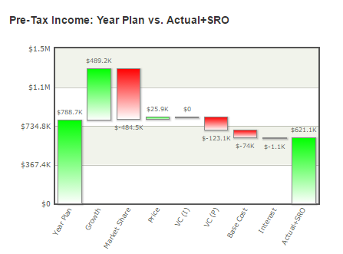
The difference between the “Actual” and “Actual + SRO” chart is that while the “Actual” chart shows what has already
happened, the “Actual + SRO” chart (above) shows you what has happened so far, plus what will happen if you
hit all future quarters EXACTLY as planned. Keep in mind that it is virtually impossible to come in exactly on target for all
future quarters. This chart will help you determine what to consider as you make your decisions for future quarters.

